Slide 1
Import and Export Data
Microsoft Access 2013
Lesson 14

Slide 2
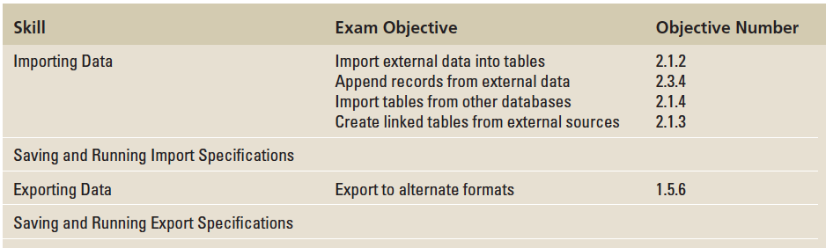
Objectives

Slide 3
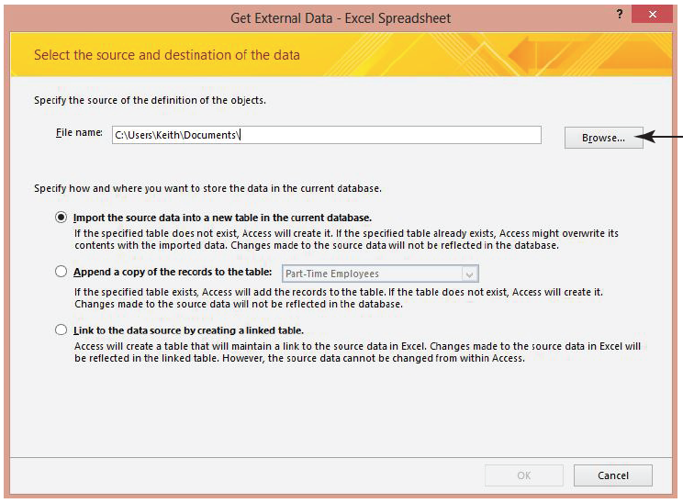
Step by Step: Import Data from Excel
GET READY. Before you begin these steps, be sure to LAUNCH Microsoft Access.
OPEN the Tailspin data- base from the data files for this lesson.
SAVE the database as TailspinXXX (where XXX is your initials).
On the EXTERNAL DATA tab, in the Import & Link group, click Excel. The Get External Data—Excel Spreadsheet dialog box appears, as shown above.
Click Browse to open the File Open dialog box.

Slide 4
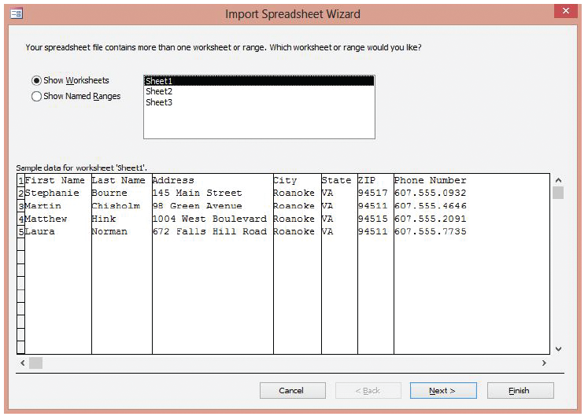
Step by Step: Import Data from Excel
Use the File Open dialog box to locate the New_Employees spreadsheet file and then click Open.
Notice the three options you have when importing data. Select the option button for Import the source data into a new table in the current database and click OK. The Import Spreadsheet Wizard appears, as shown above.
Notes:
Take Note: In the Get External Data—Excel Spreadsheet dialog box, Access also allows you to append a copy of the records to an existing table in the database. You can choose Append a copy of the records to the table and then select an available table from the drop-down list.

Slide 5
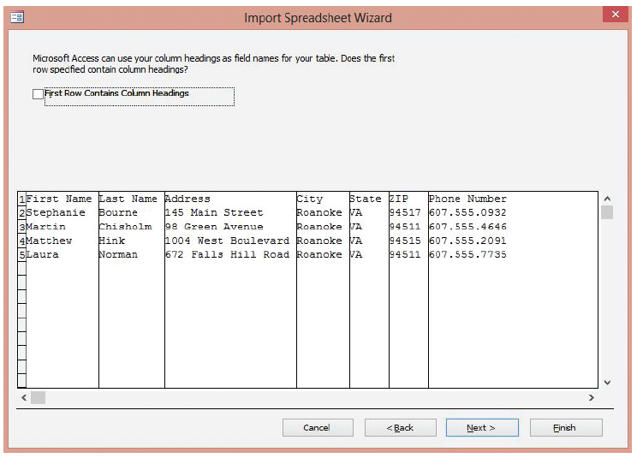
Step by Step: Import Data from Excel
Click Next > to display the next screen, as shown at right.
Click the First Row Contains Column Headings check box. Access uses these column headings to name the fields in the table.

Slide 6
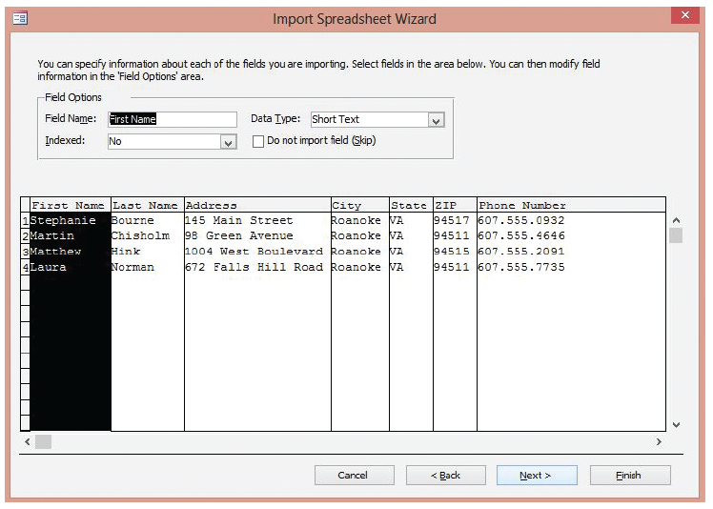
Step by Step: Import Data from Excel
Click Next > to display the next screen, shown at right, where the wizard prompts you to review the field properties.
Click the ZIP column header to display the corresponding field properties.

Slide 7
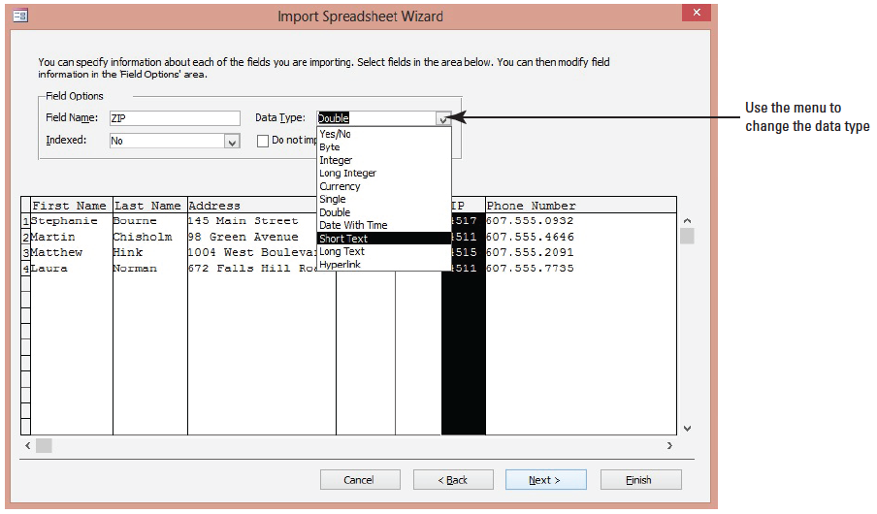
Step by Step: Import Data from Excel
Click the Data Type: down arrow and click Short Text, as shown below.
Notes:
Take Note: Access reviews the first eight rows in each column to suggest the data type for the corresponding field. If the column contains different types of values, the wizard suggests a data type that is compatible with all of the values in the column—usually the Short Text data type. Although you can choose a different data type, values that are not compatible with the chosen data type will be ignored or converted incorrectly during the import process.

Slide 8
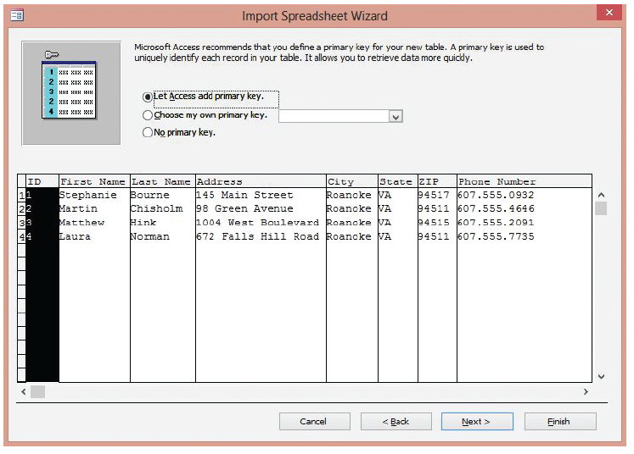
Step by Step: Import Data from Excel
Click Next > to display the next screen, as shown at right.

Slide 9
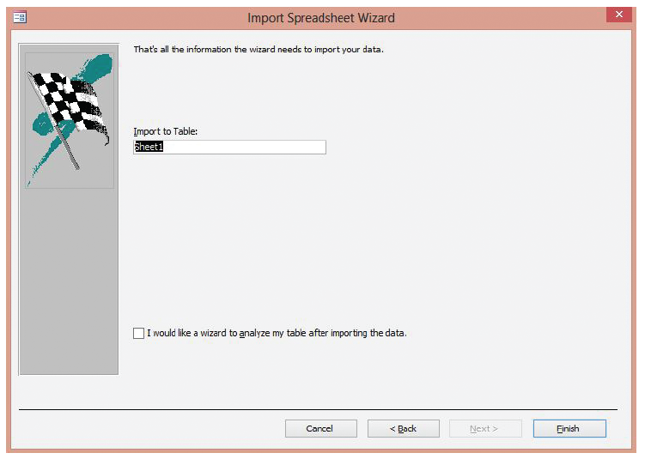
Step by Step: Import Data from Excel
Click Next > to let Access add the primary key. The final screen appears, as shown at right.
In the Import to Table box, key New Employees and then click Finish. When the Save Import Steps prompt appears, click Close.

Slide 10
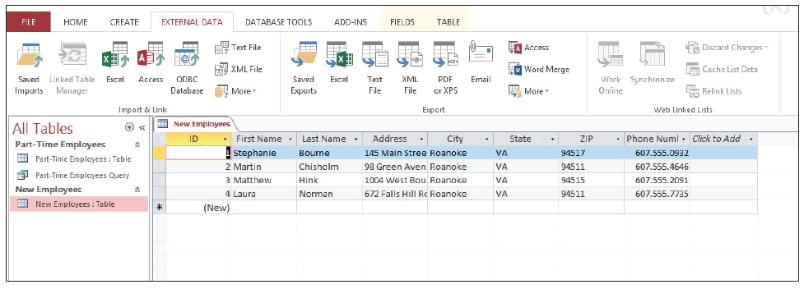
Step by Step: Import Data from Excel
In the Navigation Pane, double-click the New Employees: Table to open the new table with imported data, as shown below.
CLOSE the New Employees table.
PAUSE. LEAVE the database open for the next exercise.

Slide 11
Step by Step: Import Table Data from Another Access Database
USE the database that is open from the previous exercise.
On the EXTERNAL DATA tab, in the Import & Link group, click Access. The Get External Data—Access Database dialog box appears.
Click Browse to open the File Open dialog box.
Use the File Open dialog box to locate the Minute Insurance Access database file and then click Open.

Slide 12
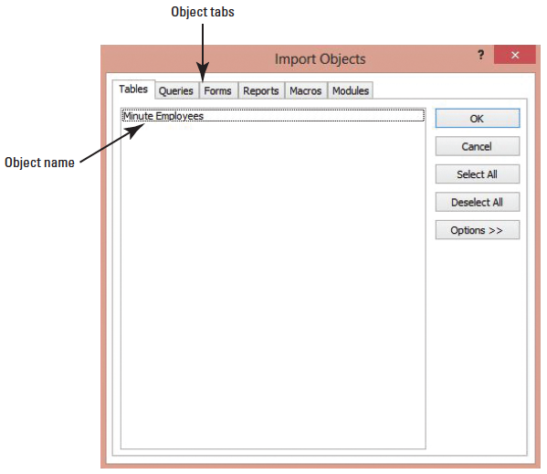
Step by Step: Import Table Data from Another Access Database
In the Get External Data—Access Database dialog box, click OK. The Import Objects dialog box appears, as shown at right. Notice the Tables object tab is selected by default.
Notes:
Take Note: You can import a variety of Access database objects into another Access database. Objects can be found by using the objects tabs at the top of the Import Objects dialog box.

Slide 13
Step by Step: Import Table Data from Another Access Database
In the Import Objects dialog box, click Minute Employees to select the table you wish to import.
Click OK to return to the Get External Data—Access Database dialog box and click Close. Notice the newly imported Minute Employees table appears in the Navigation Pane.
In the Navigation Pane, double-click the Minute Employees: Table to open the new table with imported data.
CLOSE the Minute Employees table.
PAUSE. LEAVE the database open to use in the next exercise.

Slide 14
Step by Step: Link to an External Data Source
USE the database that is open from the previous exercise.
On the EXTERNAL DATA tab, in the Import & Link group, click Excel to open the Get External Data—Excel Spreadsheet dialog box.
Click Browse to open the File Open dialog box.
Use the File Open dialog box to locate the Benefit_Providers spreadsheet file and then click Open.

Slide 15
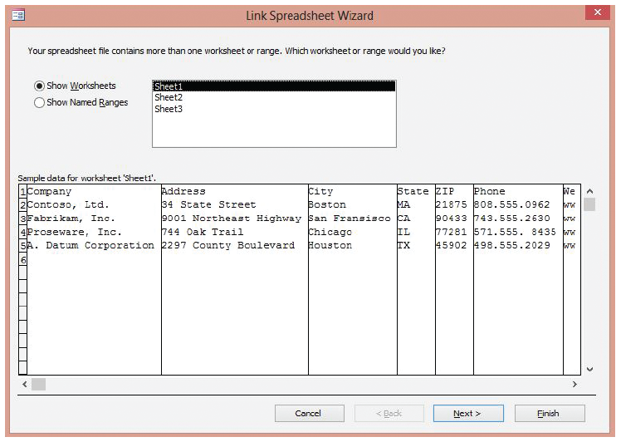
Step by Step: Link to an External Data Source
Click Link to the data source by creating a linked table and click OK. The Link Spreadsheet Wizard appears, as shown at right.
Click Next > to display the next screen.

Slide 16
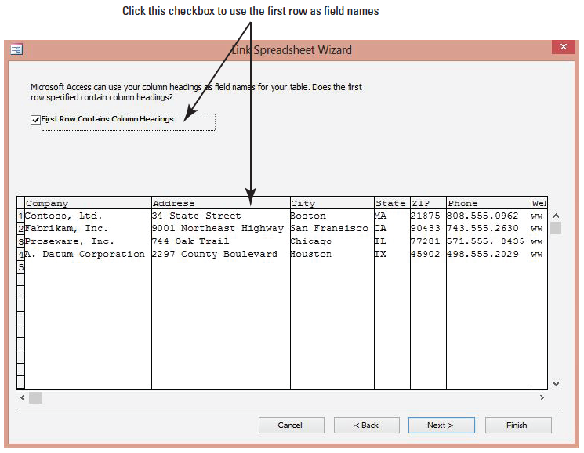
Step by Step: Link to an External Data Source
Click the First Row Contains Column Headings check box, shown at right, to use the first row of data as field names in the table.
Click Next > to display the next screen.

Slide 17
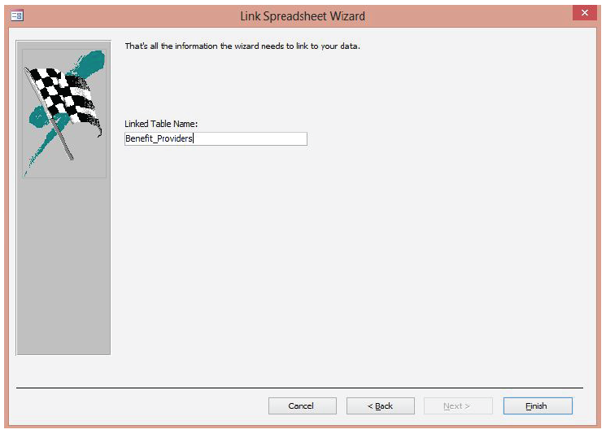
Step by Step: Link to an External Data Source
In the Linked Table Name box, key Benefit_Providers, as shown at right.
Click Finish. A Link Spreadsheet Wizard message appears informing you that Access finished linking.

Slide 18
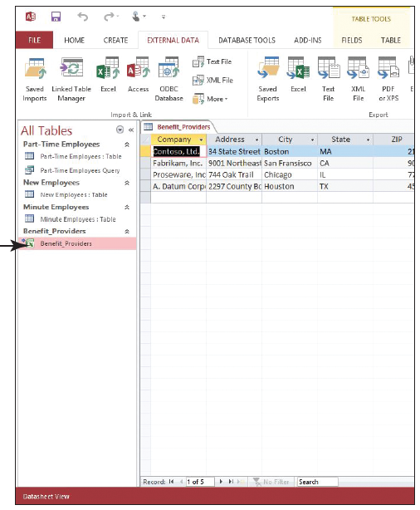
Step by Step: Link to an External Data Source
Click OK.
In the Navigation Pane, notice the linked Excel icon next to Benefit_Providers. Doubleclick Benefit_Providers to open the new linked table, shown at right. Notice that there is not an Add New Field column because the structure of a linked table cannot be changed.
Notes:
Troubleshooting: If the table with the name you specified already exists, you are asked if you want to overwrite the existing file. Click Yes if you want to overwrite the file; click No to specify a different filename.

Slide 19
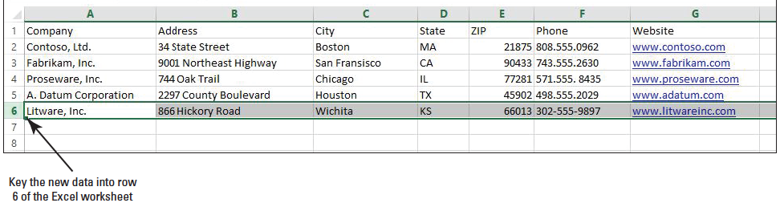
Step by Step: Link to an External Data Source
Click the Close button on Benefit_Providers to close the table.
OPEN Excel and OPEN the Benefit_Providers spreadsheet.
Key the new row of data shown below.
SAVE and CLOSE the spreadsheet.

Slide 20
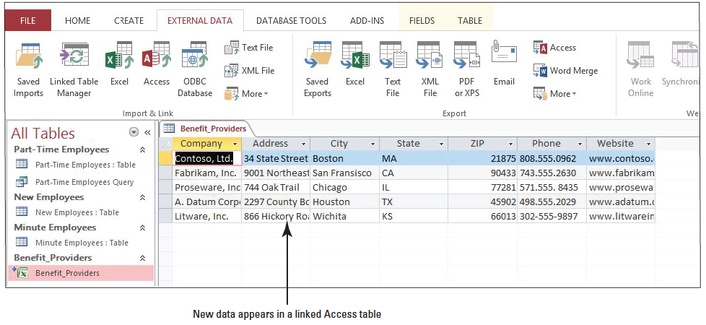
Step by Step: Link to an External Data Source
CLOSE Excel.
In the Navigation Pane of Access, double-click Benefit_ Providers to open the linked table. Notice that the new row of data has been added, as shown above.
CLOSE the Benefit_Providers table.
PAUSE. LEAVE the database open to use in the next exercise.

Slide 21
Step by Step: Save Import Specifications
USE the database that is open from the previous exercise.
On the EXTERNAL DATA tab, in the Import & Link group, click Text File to open the Get External Data—Text File dialog box.
Click Browse to open the File Open dialog box.
Use the File Open dialog box to locate the applicants text file and then click Open.

Slide 22
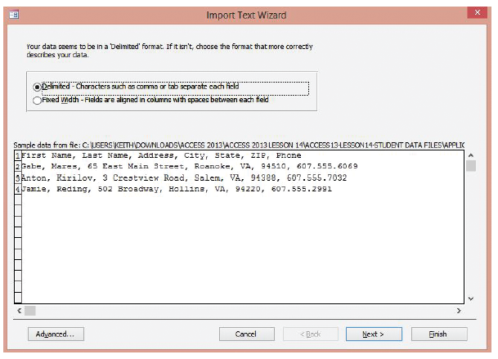
Step by Step: Save Import Specifications
Click Import the source data into a new table in the current database and click OK. The Import Text Wizard appears, as shown at right. Notice the Delimited option button is selected and the data preview of the file contains fields separated by commas. In this case, you will keep the delimited selection.

Slide 23
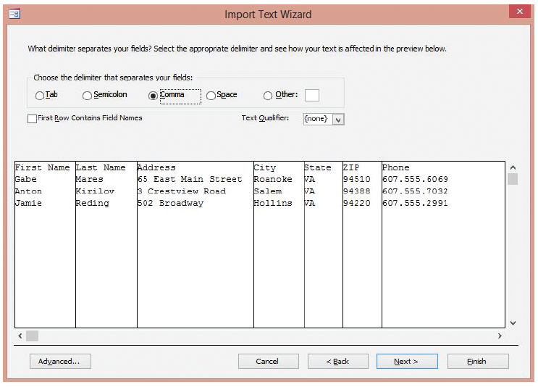
Step by Step: Save Import Specifications
Click Next > to display the next screen, shown at right.
Comma should be selected as the delimiter. Click the First Row Contains Field Names check box to use the first row of data as field names in the table.

Slide 24
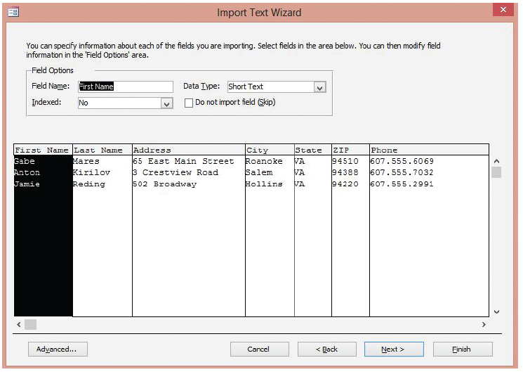
Step by Step: Save Import Specifications
Click Next > to display the next screen, shown at right, where you can specify field information.

Slide 25
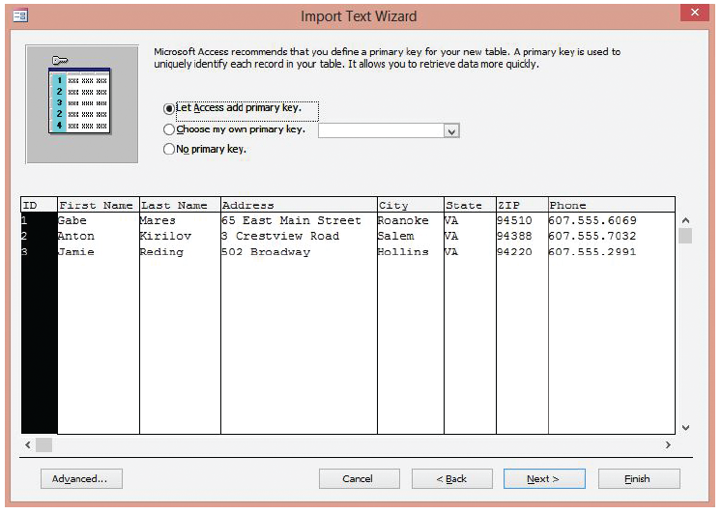
Step by Step: Save Import Specifications
Click Next > to accept the default settings and display the next screen, shown at right, where you can define a primary key.

Slide 26
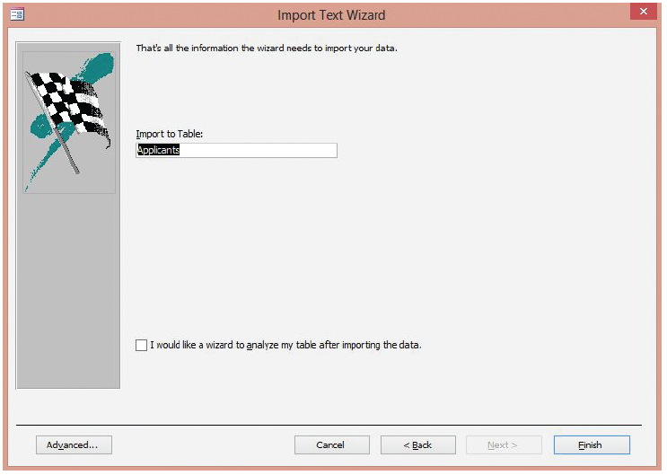
Step by Step: Save Import Specifications
Click Next > to let Access add the primary key and to display the final screen, shown at right.
Click Finish to accept the default table name. A Save Import Steps screen appears.

Slide 27
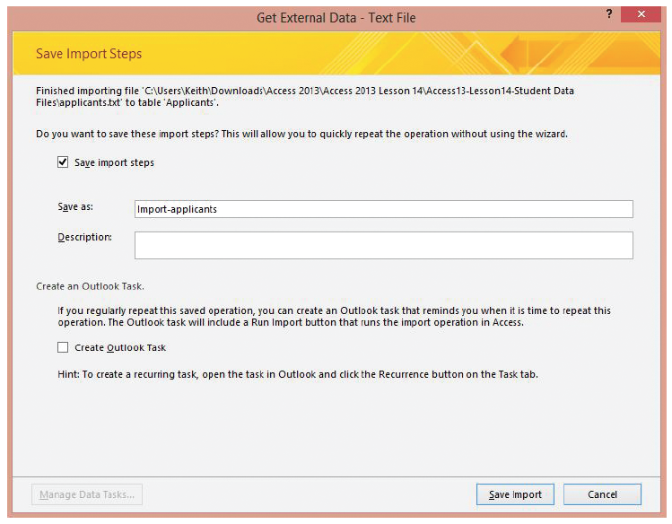
Step by Step: Save Import Specifications
Click the Save import steps check box to display the specification details, shown at right.
In the Description box, key Import text file with job applicant contact information.
Click Save Import.

Slide 28
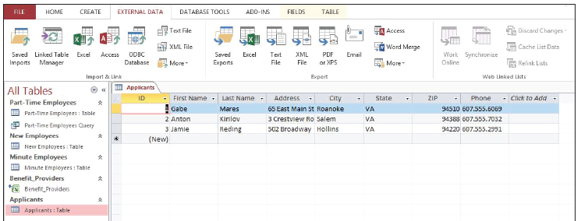
Step by Step: Save Import Specifications
In the Navigation Pane, double-click the Applicants: Table to open the new table with imported data, as shown below.
CLOSE the Applicants table.
PAUSE. LEAVE the database open for the next exercise.

Slide 29
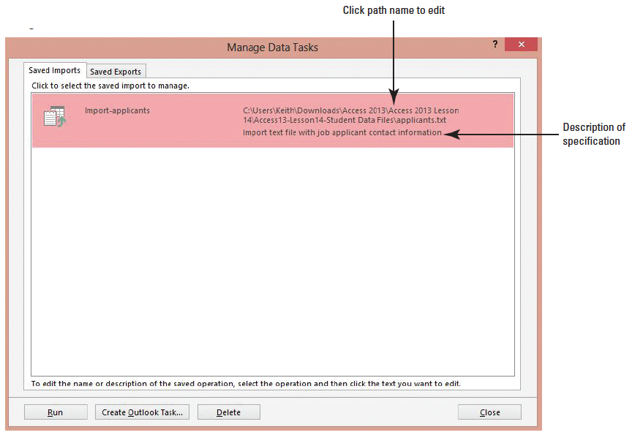
Step by Step: Run Import Specifications
USE the database that is open from the previous exercise.
On the EXTERNAL DATA tab, in the Import & Link group, click Saved Imports to open the Manage Data Tasks dialog box, shown at right.

Slide 30
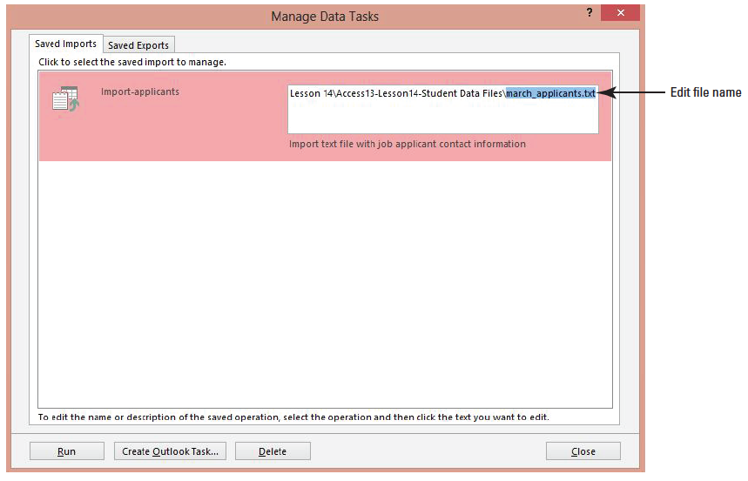
Step by Step: Run Import Specifications
Click the file path and edit it by changing the source file name to march_applicants.txt, as shown below.

Slide 31
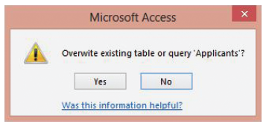
Step by Step: Run Import Specifications
Click Run. A message appears asking if you want to overwrite the existing table, as shown below.

Slide 32
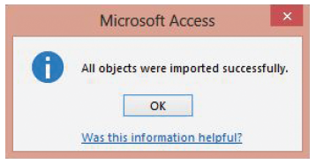
Step by Step: Run Import Specifications
Click Yes. A message appears confirming that all objects were successfully imported, as shown below.
Click OK.
Click Close to close the Manage Data Tasks dialog box.

Slide 33

Step by Step: Run Import Specifications
In the Navigation Pane, double-click the Applicants: Table to open the table. The existing data has been replaced with new imported data, as shown below.
CLOSE the Applicants table.
PAUSE. LEAVE the database open to use in the next exercise.

Slide 34
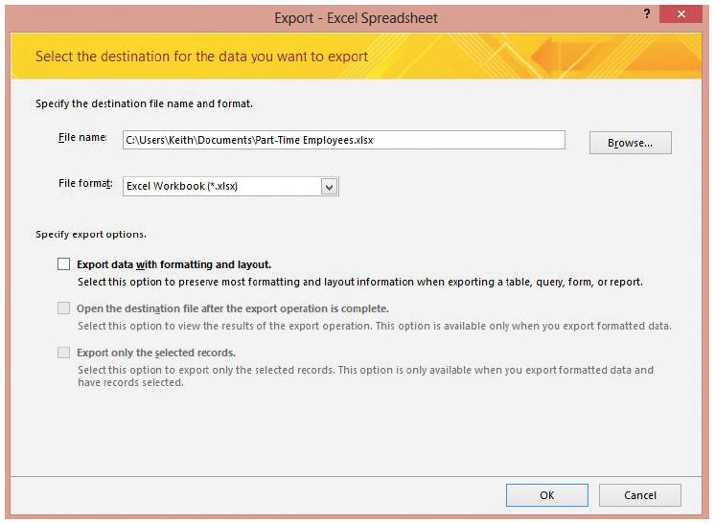
Step by Step: Exporting from a Table to Excel
USE the database that is open from the previous exercise.
In the Navigation Pane, select the Part-Time Employees: Table.
On the EXTERNAL DATA tab, in the Export group, click Excel. The Export—Excel Spreadsheet dialog box appears, as shown at right.

Slide 35
Step by Step: Exporting from a Table to Excel
If you want to specify a different destination, click Browse to open the File Save dialog box, use the File Save dialog box to choose a folder, and then click Save.
Click the Export data with formatting and layout check box and then click the Open the destination file after the export operation is complete check box.

Slide 36
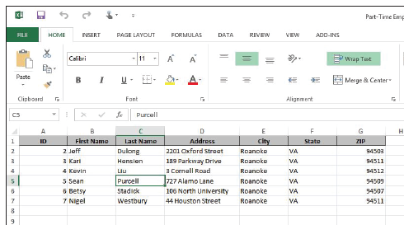
Step by Step: Exporting from a Table to Excel
Click OK. Excel opens and the new worksheet with exported data is displayed, as shown at right.
CLOSE the worksheet and CLOSE Excel.
Switch to Access.
On the Save Export Steps screen, click Close.
PAUSE. LEAVE the database open to use in the next exercise.

Slide 37
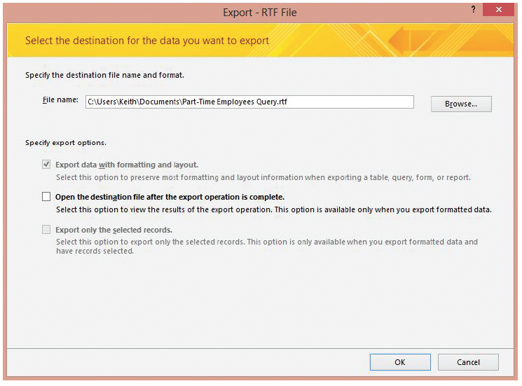
Step by Step: Export from a Query to Word
USE the database that is open from the previous exercise.
In the Navigation Pane, select the Part-Time Employees Query.
On the EXTERNAL DATA tab, in the Export group, click the More button. On the menu that appears, click Word. The Export—RTF File dialog box appears, as shown above.

Slide 38
Step by Step: Export from a Query to Word
If you want to specify a different destination, click Browse to open the File Save dialog box, use the File Save dialog box to choose a folder, and then click Save.
Click the Open the destination file after the export operation is complete check box.

Slide 39
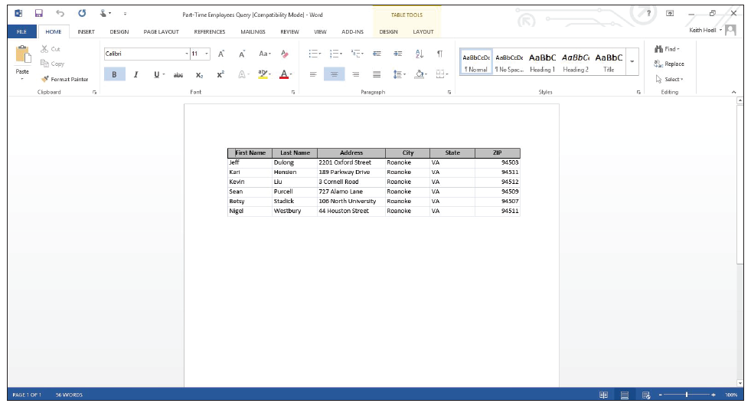
Step by Step: Export from a Query to Word
Click OK. Word opens and the new document with exported data is displayed, as shown t right.
CLOSE the document and CLOSE Word.
Switch to Access.
On the Save Export Steps screen, click Close.
PAUSE. LEAVE the database open to use in the next exercise.

Slide 40
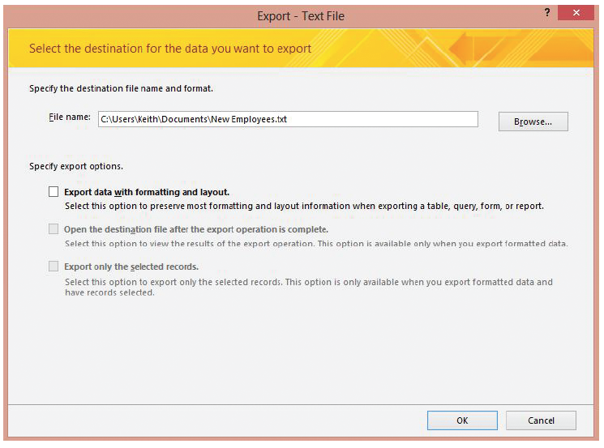
Step by Step: Save Export Specifications
USE the database that is open from the previous exercise.
In the Navigation Pane, select the New Employees: Table.
On the EXTERNAL DATA tab, in the Export group, click Text File. The Export—Text File dialog box appears, as shown above.

Slide 41
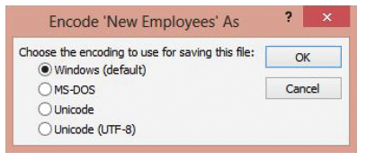
Step by Step: Save Export Specifications
If you want to specify a different destination, click Browse to open the File Save dialog box, use the File Save dialog box to choose a folder, and then click Save.
Click the Export data with formatting and layout check box and then click the Open the destination file after the export operation is complete check box.
Click OK. The Encode ‘New Employees’ As dialog box is displayed, as shown below.

Slide 42
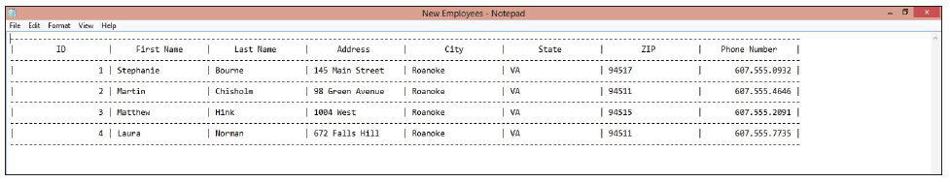
Step by Step: Save Export Specifications
Windows (default) should be selected. Click OK. Notepad opens and the new file with exported data is displayed, as shown below.
CLOSE Notepad.
Switch to Access.

Slide 43
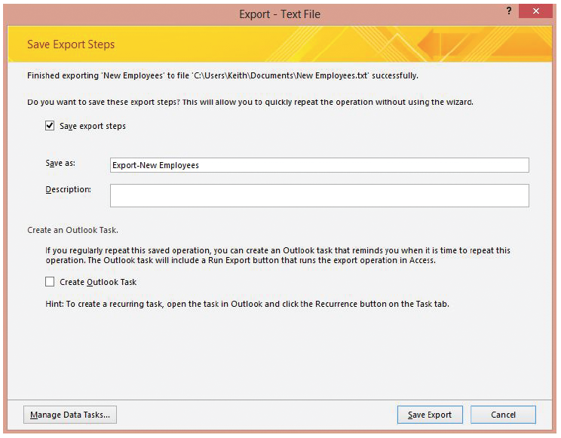
Step by Step: Save Export Specifications
On the Save Export Steps screen, click the Save export steps check box to display the specification details, as shown at right.

Slide 44
Step by Step: Save Export Specifications
In the Description box, key Export new employee information to a text file.
Click Save Export.
PAUSE. LEAVE the database open to use in the next exercise.

Slide 45
Step by Step: Run Export Specifications
USE the database that is open from the previous exercise.
In the Navigation Pane, double-click the New Employees: Table to open it, if necessary.
Add another record with the following information: First Name: Rachel Last Name: Valdez Address: 39 Vista Drive City: Roanoke State: VA ZIP: 94510
Phone Number: 607.555.1218
Click the Close ‘New Employees’ button to close the table.

Slide 46
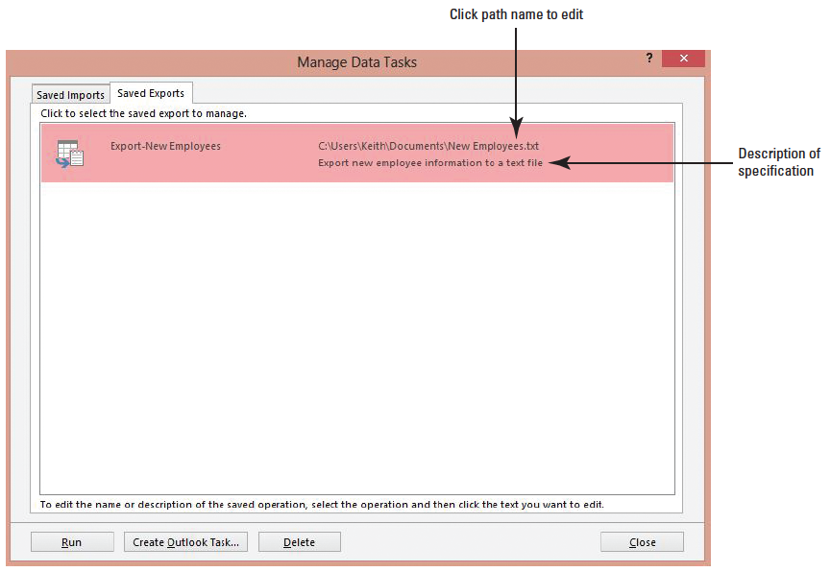
Step by Step: Run Export Specifications
On the EXTERNAL DATA tab, in the Export group, click Saved Exports to open the Manage Data Tasks dialog box, as shown below.

Slide 47
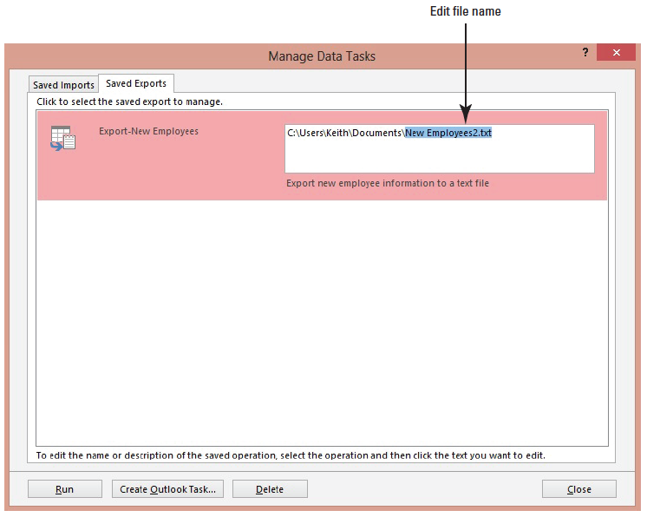
Step by Step: Run Export Specifications
Click the file path and edit it by changing the destination file name to New Employees2.txt, as shown below.

Slide 48
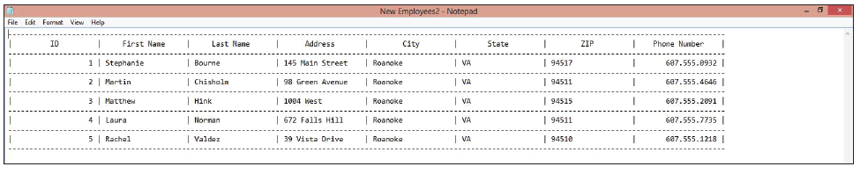
Step by Step: Run Export Specifications
Click Run. Notepad opens and the new file with exported data is displayed, as shown below.

Slide 49
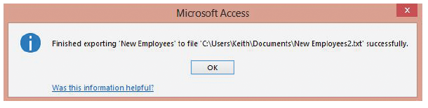
Step by Step: Run Export Specifications
Switch to Access. A message confirms that the export operation was successful, as shown below.

Slide 50
Step by Step: Run Export Specifications
Click OK and then click Close to close the Manage Data Tasks dialog box.
CLOSE Notepad.
CLOSE the database.
PAUSE. LEAVE Access open to use in the projects.

Slide 51
Skill Summary

